Slide 1
Ancient Greece

Slide 2
Ancient Greece was an ancient civilization belonging to a period of Greek history that lasted from the Archaic period of the 8th to 6th centuries BC to the end of antiquity (ca. 600 AD). Immediately following this period was the beginning of the Early Middle Ages and the Byzantine era. Included in Ancient Greece is the period of Classical Greece, which flourished during the 5th to 4th centuries. Classical Greek Culture especially philosophy, had a powerful influence on the Roman Empire, which carried a version of it to many parts of the Mediterranean region and Europe, for which reason Classical Greece is generally considered to be the seminal culture which provided the foundation of modern Western Culture.

Slide 3
A map showing the Greek territories and colonies during the Archaic period

Slide 4
Left: Early Athenian coin, depicting the head of Athena on the obverse and her owl on the reverse—5th century BC Right: Gravestone of a woman with her slave child-attendant, c. 100 BC

Slide 5
The theatre of Epidauros, 4th century BC The Greek Theater was a central place of formal gatherings in ancient Greece. Not only did the structure serve as the stage for Tragedies and Comedies, but it also provided a forum for poetry and musical events.

Slide 6
This was many of their inventions called the Antikythera mechanism. It was an analog computer from 150–100 BC designed to calculate the positions of astronomical objects.

Slide 7
Greek cities & colonies c. 550 BC.

Slide 8
Plato was a philosopher in Classical Greece. He was also a mathematician, student of Socrates, writer of philosophical dialogues, and founder of the Academy in Athens, the first institution of higher learning in the Western world. Along with his mentor, Socrates, and his student, Aristotle, Plato helped to lay the foundations of Western philosophy and science.

Slide 9
Aristotle (384 BC – 322 BC) was a Greek philosopher and polymath, a student of Plato and teacher of Alexander the Great. His writings cover many subjects, including physics, metaphysics, poetry, theater, music, logic, rhetoric, linguistics, politics, and Government. Together with Plato and Socrates (Plato's teacher), Aristotle is one of the most important founding figures in Western philosophy. Aristotle's writings were the first to create a comprehensive system of Western philosophy, encompassing ethics, aesthetics, logic, science, politics, and metaphysics.

Slide 10
Socrates was a classical Greek philosopher. Credited as one of the founders of Western philosophy, he is an enigmatic figure known chiefly through the accounts of later classical writers, especially the writings of his students Plato and Xenophon. Many would claim that Plato's dialogues are the most comprehensive accounts of Socrates to survive from antiquity. Socrates has become renowned for his contribution to the field of ethics.

Slide 11
Athletic events provided the opportunity for all the city-states of Greece to gather and to strengthen their common bonds through competition. Athletic events were a great spectacle in antiquity and for many a peasant the only form of grand entertainment. The Olympic games were born in these stadiums, while wars and disputes among countries were put aside while the games were on.

Slide 12
Minoan Palace of Knossos, inhabited for several thousand years. It was destroyed for the first time along with the other palaces around Crete at 1700 BC, probably by a large earthquake or foreign invaders. According to Greek mythology, the palace was designed by famed architect Dedalos with such complexity that no one placed in it could ever find its exit

Slide 13
Above are two examples of Ancient Greece art.

Slide 14
For most of Greek history, education was private, except in Sparta. Some cities had public schools. Boys learned how to read, write and quote literature. They also learned to sing and play one musical instrument and were trained as athletes for military service. They studied not for a job but to become an effective citizen. Girls also learned to read, write and do simple arithmetic so they could manage the household. They almost never received education after childhood.

Slide 15
Herodotus was an ancient Greek historian who was born in Halicarnassus, Caria (modern day Turkey) and lived in the fifth century BC (c. 484–425 BC). He has been called "The Father of History "and was the first historian known to collect his materials systematically. As historian, Herodotus was sarcastically referred as the father of lies for "quoting eyewitnesses about things they could have never seen, inventing and manipulating factual material."

Slide 16
Thucydides (460 – c. 395 BC) was a Greek historian and Athenian general. His History of the Peloponnesian War recounts the 5th century BC war between Sparta and Athens to the year 411 BC. Thucydides has been dubbed the father of "scientific history" because of his strict standards of evidence-gathering and analysis in terms of cause and effect without reference to intervention by the gods, as outlined in his introduction to his work. His text is still studied at advanced military colleges worldwide.

Slide 17
The ruins of Ancient Sparta.

Slide 18
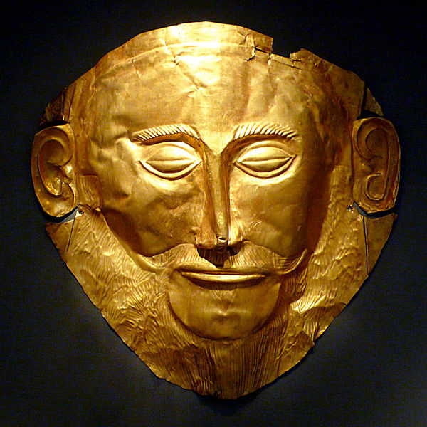
Golden Mask of Agamemon found by Henrich Schliemann at the royal grave circle at Mycenae

Slide 19
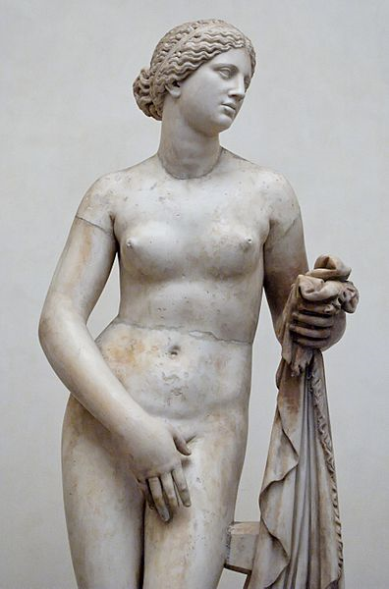
Aphrodite
Goddess of love, beauty, desire, and pleasure. Although married to Hephaestus she had many lovers, most notably Ares, Adonis, and Anchises. She was depicted as a beautiful woman and of all the goddesses most likely to appear nude or seminude. Poets praise the radiance of her smile and her laughter. Her symbols include roses and other flowers, the scallop shell, and myrtle wreath. Her sacred animals are doves and sparrows. Her Roman counterpart was Venus.

Slide 20
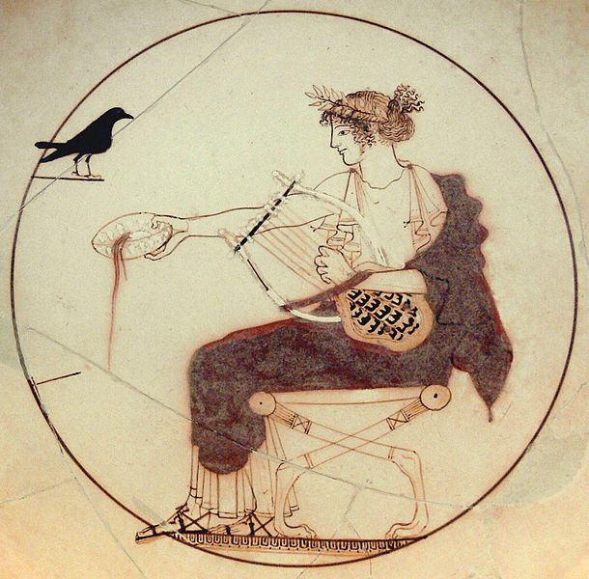
Apollo
God of light, music, arts, knowledge, healing, plague and darkness, prophecy, poetry, purity, athletism, manly beauty, and enlightenment. He is the son of Zeus and Leto, and the twin brother of Artemis. As brother and sister, they were identified with the sun and moon; both use a bow and arrow. In the earliest myths, Apollo contends with his half-brother Hermes. In sculpture, Apollo was depicted as a very handsome, beardless young man with long hair and an ideal physique. As the embodiment of perfectionism, he could be cruel and destructive, and his love affairs were rarely happy. His attributes include the laurel wreath and lyre. He often appears in the company of the Muses. Animals sacred to Apollo include roe deer, swans, cicadas, hawks, ravens, crows, foxes, mice, and snakes.

Slide 21
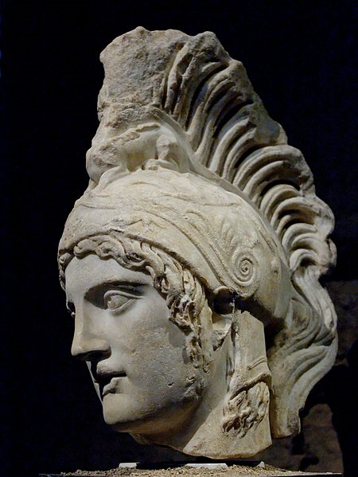
Ares
God of war, bloodshed, and violence. The son of Zeus and Hera, he was depicted as a beardless youth, either nude with a helmet and spear or sword, or as an armed warrior. Homer portrays him as moody and unreliable, and he generally represents the chaos of war in contrast to Athena, a goddess of military strategy and skill. Ares' sacred animals are the vulture, venomous snakes, dogs, and boars. His Roman counterpart Mars by contrast was regarded as the dignified ancestor of the Roman people.

Slide 22
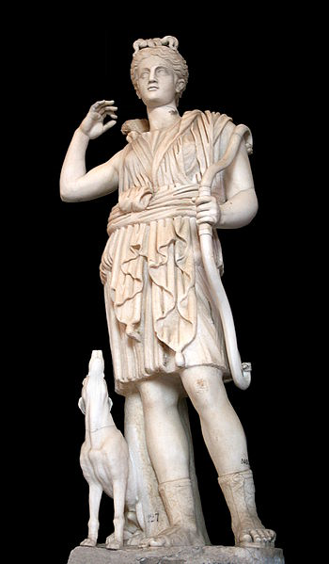
Artemis
Virgin goddess of the hunt, wilderness, animals, young girls, childbirth and plague. In later times she became associated with the moon. She is the daughter of Zeus and Leto, and twin sister of Apollo. In art she was often depicted as a young woman dressed in a short knee-length chiton and equipped with a hunting bow and a quiver of arrows. Her attributes include hunting spears, animal pelts, deer and other wild animals. Her sacred animals are deer, bears, and wild boars. Diana was her Roman counterpart.

Slide 23
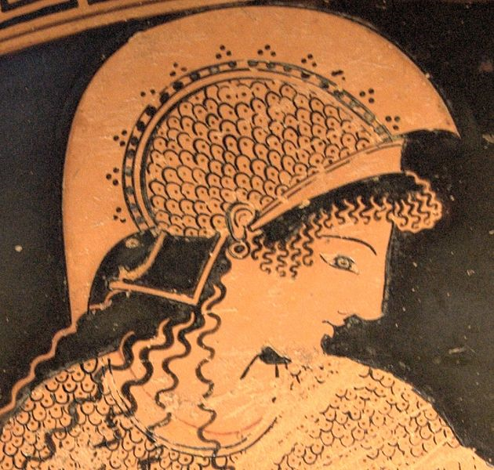
Athena
Goddess of intelligence and skill, warfare, battle strategy, handicrafts, and wisdom. According to most traditions, she was born from Zeus's head fully formed and armored. She was depicted crowned with a crested helm, armed with shield and a spear, and wearing the aegis over a long dress. Poets describe her as "grey-eyed" or having especially bright, keen eyes. She was a special patron of heroes such as Odysseus. She was also the patron of the city Athens (which was named after her) Her symbol is the olive tree. She is commonly shown accompanied by her sacred animal, the owl. The Romans identified her with Minerva.

Slide 24
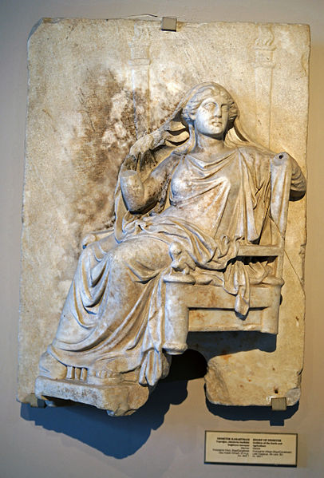
Demeter
Goddess of grain, agriculture and the harvest, growth and nourishment. Demeter is a daughter of Cronus and Rhea and sister of Zeus, by whom she bore Persephone. She was one of the main deities of the Eleusinian Mysteries, in which her power over the life cycle of plants symbolized the passage of the human soul through its life course and into the afterlife. She was depicted as a mature woman, often crowned and holding sheafs of wheat and a torch. Her symbols are the cornucopia, wheat-ears, the winged serpent, and the lotus staff. Her sacred animals are pigs and snakes. Ceres was her Roman counterpart.

Slide 25
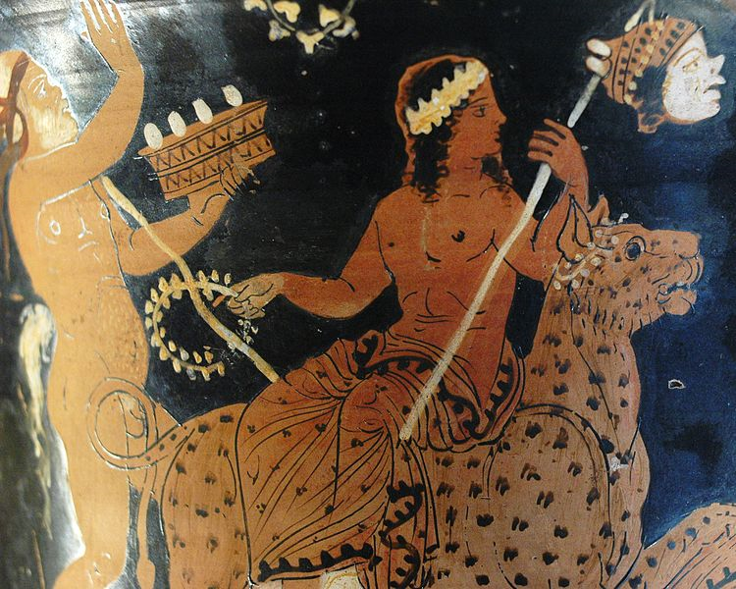
Dionysus
God of wine, parties and festivals, madness, chaos, drunkenness, drugs, and ecstasy. He was depicted in art as either an older bearded god or a pretty effeminate, long-haired youth. His attributes include the thyrsus (a pinecone-tipped staff), drinking cup, grape vine, and a crown of ivy. He is often in the company of his thiasos, a posse of attendants including satyrs, maenads, and his old tutor Silenus. The consort of Dionysus was Ariadne. Animals sacred to him include dolphins, serpents, tigers, and donkeys. A later addition to the Olympians, in some accounts he replaced Hestia. Bacchus was another name for him in Greek, and came into common usage among the Romans.

Slide 26
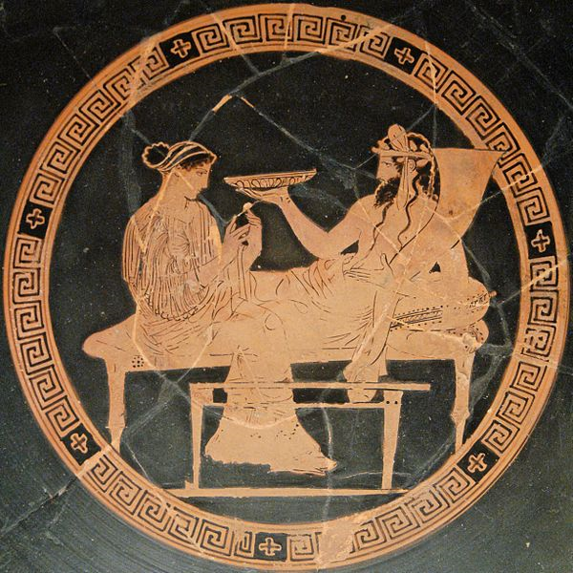
Hades
King of the underworld and the dead, and god of the earth's hidden wealth, both agricultural produce and precious metals. His consort is Persephone. His attributes are the drinking horn or cornucopia, key, sceptre, and the three-headed dog Cerberus. The screech owl was sacred to him. He was one of three sons of Cronus and Rhea, and thus sovereign over one of the three realms of the universe, the underworld. As a chthonic god, however, his place among the Olympians is ambiguous. In the mystery religions and Athenian literature, Pluto (Plouton, "the Rich") was his preferred name, with Hades more common for the underworld as a place. The Romans translated Plouton as Dis Pater ("the Rich Father") or Pluto.

Slide 27
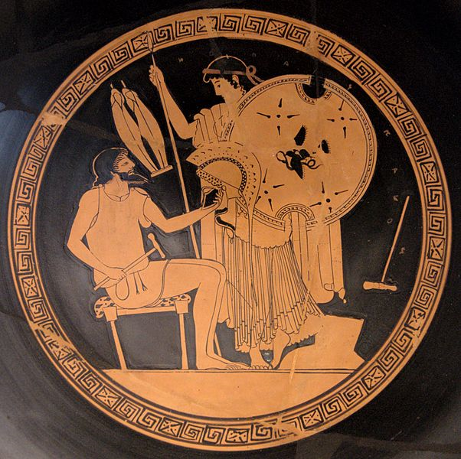
Hephaestus
Crippled god of fire, metalworking, and crafts. The son of Hera by parthenogenesis, he is the smith of the gods and the husband of the adulterous Aphrodite. He was usually depicted as a bearded man with hammer, tongs and anvil—the tools of a smith—and sometimes riding a donkey. His sacred animals are the donkey, the guard dog and the crane. Among his creations was the armor of Achilles. Hephaestus used the fire of the forge as a creative force, but his Roman counterpart Volcanus (Vulcan) was feared for his destructive potential and associated with the volcanic power of the earth.

Slide 28
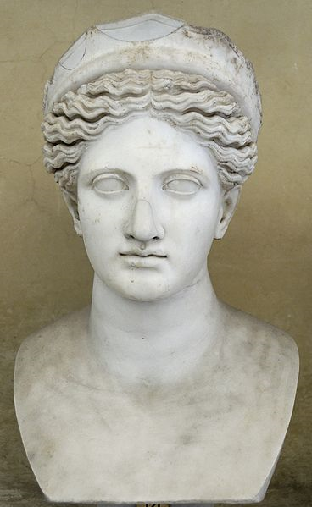
Hera
Queen of the heavens and goddess of marriage, women, childbirth, heirs, kings, and empires. She is the wife of Zeus and daughter of Cronus and Rhea. She was usually depicted as a regal woman in the prime of her life, wearing a diadem and veil and holding a lotus-tipped staff. Although she was the goddess of marriage, Zeus's many infidelities drive her to jealousy and vengefulness. Her sacred animals are the heifer, the peacock, and the cuckoo. At Rome she was known as Juno.

Slide 29
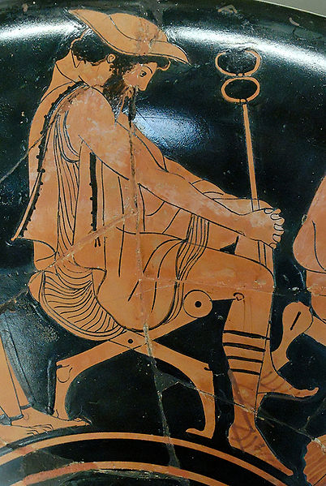
Hermes
God of boundaries, travel, communication, trade, thievery, trickery, language, writing, diplomacy, athletics, and animal husbandry. The son of Zeus and Maia, Hermes is the messenger of the gods, and a psychopomp who leads the souls of the dead into the afterlife. He was depicted either as a handsome and athletic beardless youth, or as an older bearded man. His attributes include the herald's wand or caduceus, winged sandals, and a traveler's cap. His sacred animals are the tortoise, the ram, and the hawk. The Roman Mercury was more closely identified with trade and commerce.

Slide 30
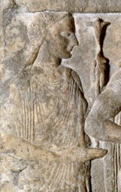
Hestia
Virgin goddess of the hearth, home and chastity. She is a daughter of Rhea and Cronus and sister of Zeus. Not often identifiable in Greek art, she appeared as a modestly veiled woman. Her symbols are the hearth and kettle. In some accounts, she gave up her seat as one of the Twelve Olympians in favor of Dionysus, and she plays little role in Greek myths. Her counterpart Vesta, however, was a major deity of the Roman state.

Slide 31
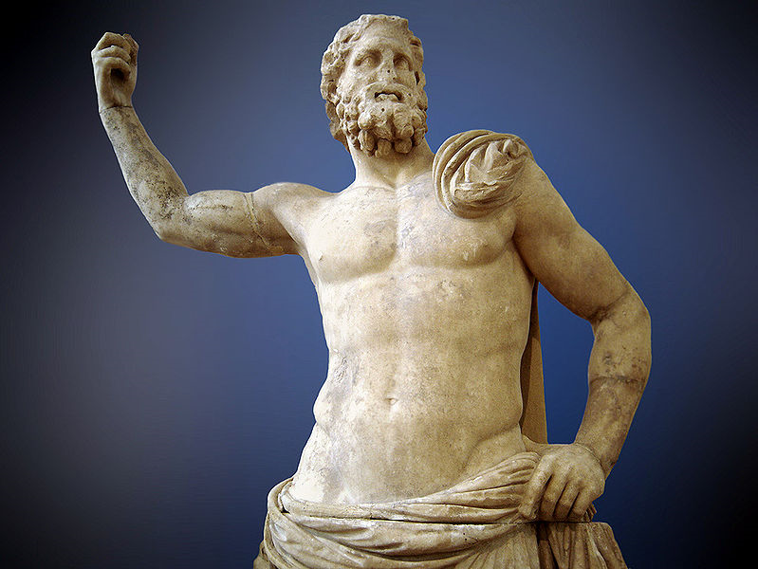
Poseidon
God of the sea, rivers, floods, droughts, earthquakes, and the creator of horses; known as the "Earth Shaker". He is a son of Cronus and Rhea and brother to Zeus and Hades. He rules one of the three realms of the universe as king of the sea and the waters. In classical artwork, he was depicted as a mature man of sturdy build with an often luxuriant beard, and holding a trident. The horse and the dolphin are sacred to him. His wedding with Amphitrite is often presented as a triumphal procession. His Roman counterpart was Neptune.

Slide 32
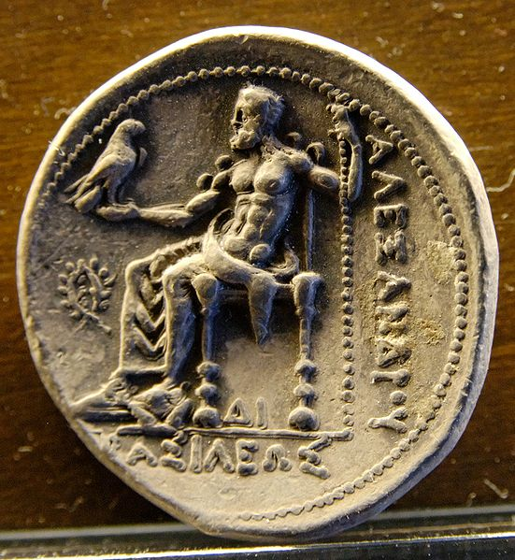
Zeus
King of the gods, the ruler of Mount Olympus and the god of the sky, weather, thunder, lightning, law, order, and fate. He is the youngest son of Cronus and Rhea. He overthrew Cronus and gained the sovereignty of heaven for himself. In artwork, he was depicted as a regal, mature man with a sturdy figure and dark beard. His usual attributes are the royal scepter and the lightning bolt, and his sacred animals are the eagle and the bull. His counterpart Jupiter, also known as Jove, was the supreme deity of the Romans.

Slide 33
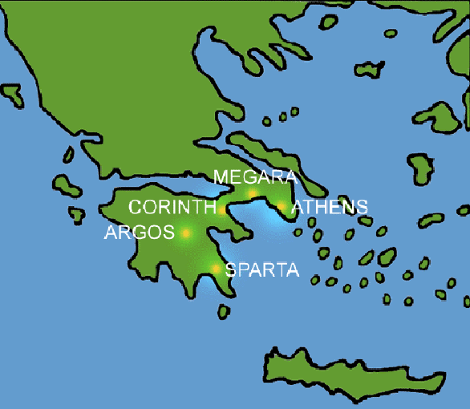
Ancient Greek City States

